Slide 1

Retail Insights from Superstore Data
-MUNI TEJASREE

Slide 2

PROBLEM STATEMENT
Analyzing retail data from a superstore to uncover actionable insights that can optimize operations and improve profitability. The analysis should focus on understanding customer purchasing behavior, identifying trends in product sales, exploring geographical sales patterns, and recommending strategies to enhance overall business efficiency and customer satisfaction.

Slide 3
Project Description
The project aims to conduct comprehensive data analysis on a dataset from a retail superstore to derive valuable insights that can drive strategic decision-making and operational improvements. The dataset includes various attributes such as Ship Mode, Segment, Country, City, State, Postal Code, Region, Category, Sub-Category, Sales, Quantity, Discount, and Profit. By analyzing these dimensions, the project seeks to uncover patterns, trends, and correlations that can help optimize business processes and enhance profitability.
Objectives:
Customer Segmentation and Behavior Analysis:
Segment customers based on demographic attributes (Segment, Country, City, State).
Analyze purchasing behavior (Sales, Quantity, Discount) across different customer segments.
Product Performance Analysis:
Evaluate the sales performance of different product categories and sub-categories.
Identify best-selling products and profitability by category.
Geographical Insights:
Explore regional sales trends and variations (Region, City, State).
Analyze the impact of location-specific factors on sales and profitability.
Profitability and Cost Optimization:
Assess profitability metrics (Profit, Discount) across product categories.
Identify areas for cost reduction and margin improvement.
Operational Efficiency Recommendations:
Recommend strategies to optimize shipping modes (Ship Mode) based on cost and delivery efficiency.
Suggest improvements in inventory management and supply chain operations.

Slide 4

WHO ARE THE END USERS?
Operations Managers
Marketing Analysts
Supply Chain Managers
Sales Executives

Slide 5

Technology Used
Data Analysis and Visualization:
Python: Programming language used with libraries such as Pandas (data manipulation), NumPy (numerical computing), and SciPy (scientific computing).
Jupyter Notebooks: Interactive computing environments for data analysis, visualization, and machine learning prototyping.
Matplotlib, Seaborn: Python libraries for creating static and interactive visualizations.

Slide 6
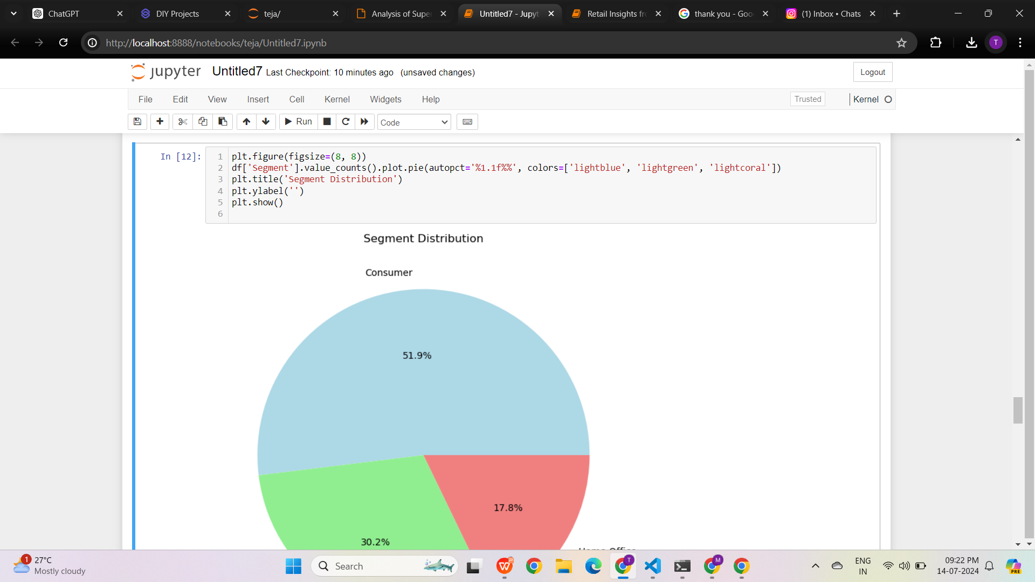
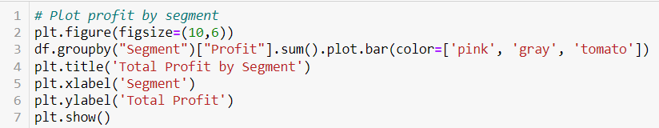
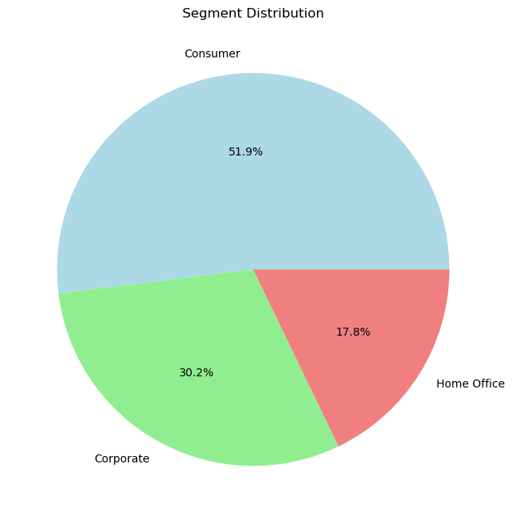
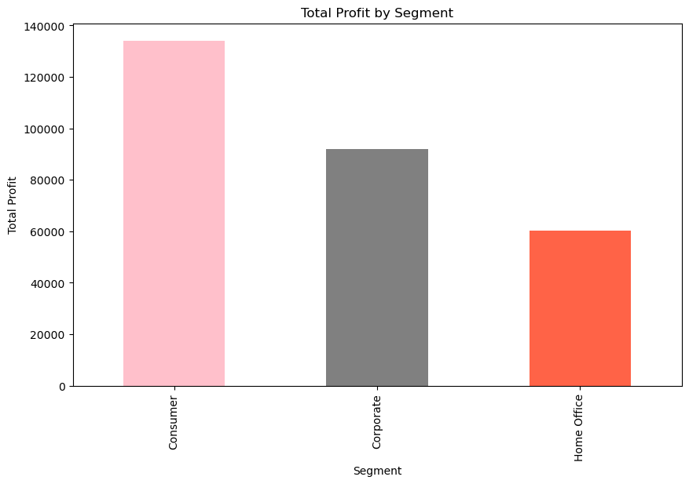
RESULTS
______________________________________________
Demo Link

Slide 7
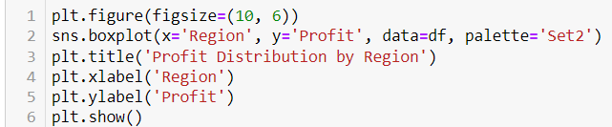
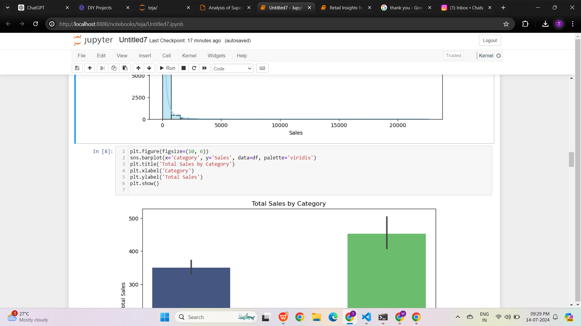
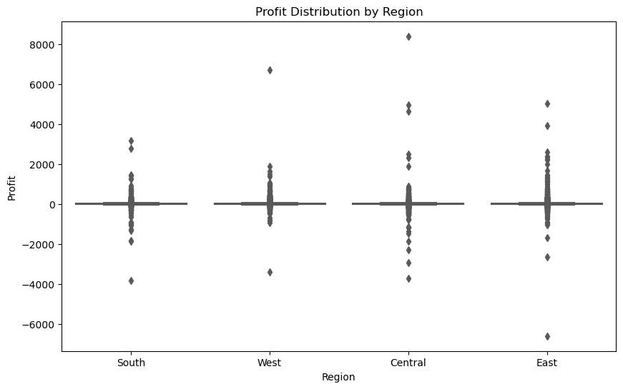
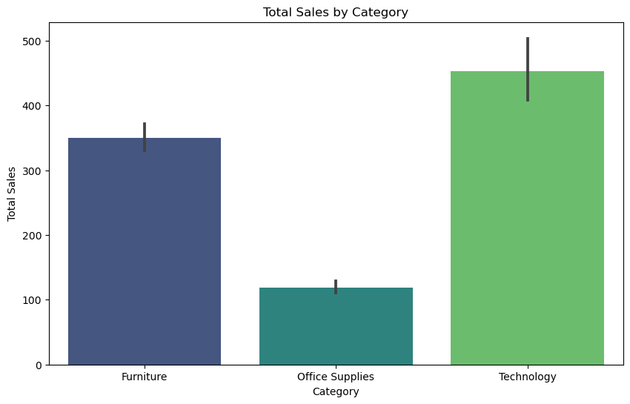
______________________________________________

Slide 8
GitHub repository link::
https://github.com/Munitejasree06/retail-super-store-data-analysis

Slide 9

.
.

